Slide 1
Sharing
Your
Challenge
Software Engineering | Digitale Transformation
Neil Thompson | December 2023

Slide 2

About Me
Managing Consultant at ACCSO
Husband, Father ,Developer, Gamer
See myself as a full stack developer, I love both front and back end development. In my free time i like to play around with some game development and other small applications.

Slide 3
Creating Real-Time Applications with SignalR

Slide 4
Creating Real-Time Applications with SignalR
What is SignalR
Key Concepts
SignalR Scaleout
Real-World Use Cases
Building a Real-Time App (DEMO)
Reference Documentation and Questions

Slide 5

What is SignalR ?
SignalR is an open-source library that simplifies adding real-time web functionality to apps.
Real-time web functionality enables server-side code to push content to clients instantly.

Slide 6

Key Concepts of SignalR
Bidirectional Communication
SignalR facilitates real-time, bidirectional communication between clients and servers. Unlike traditional models, both parties can send messages independently, allowing for instant updates.
Hubs
Hubs act as high-level abstractions that enable communication between clients and servers. They simplify the process of organizing connections and sending messages.
Connection Manager
Each client establishes a connection to the server, creating a persistent channel for communication. The connection Manager in SignalR keeps track of connected clients managing their lifecycle and handling events like connection, reconnection, and disconnection
Message Handling
SignalR uses a messaging system to send data between clients and servers. Messages can be simple text, JSON, or even binary data, depending on the application's requirements
Groups
SignalR allows clients to be organized into groups, enabling targeted message broadcasting. This feature is particularly useful for scenarios where specific subsets of clients need to receive updates.

Slide 7
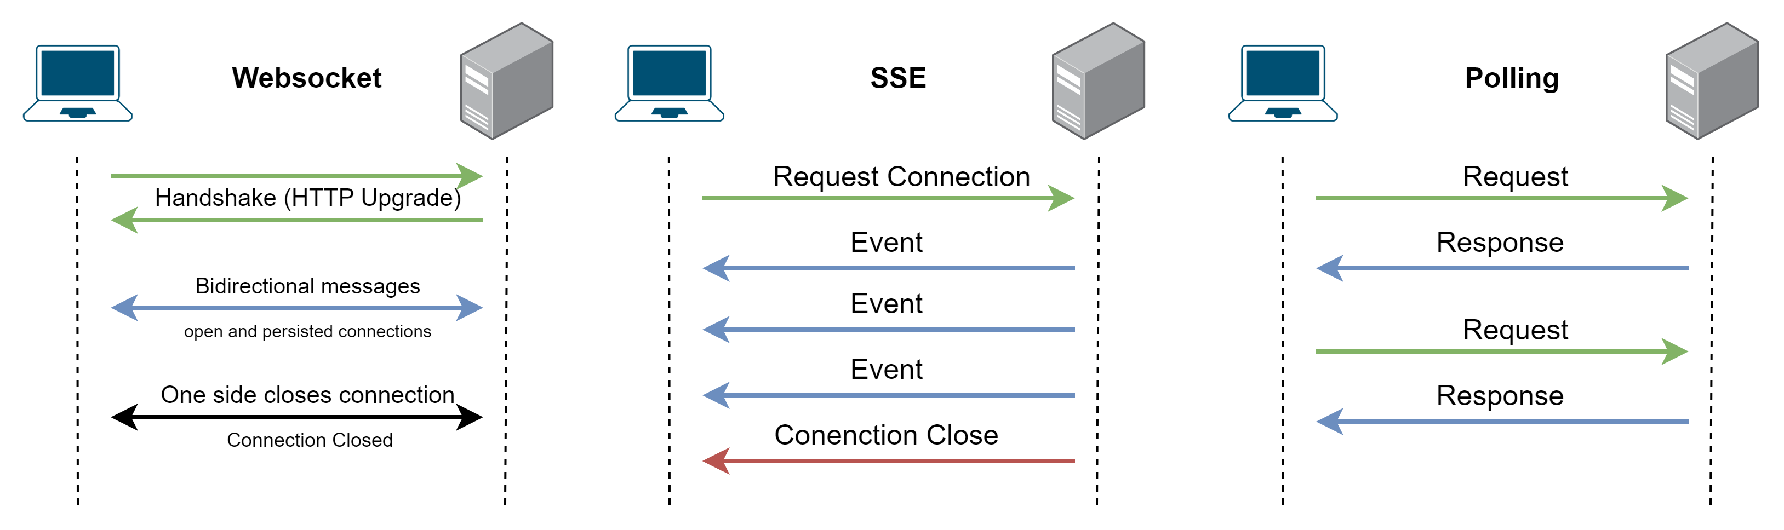
Key Concepts of SignalR
Transport Layer
SignalR supports multiple transport mechanisms, and the framework intelligently selects the most suitable based on the capabilities of the client and server.
WebSockets (Upgrade header to change from HTTP Protocol to Websocket Protocol)
Server-Sent Events (SSE)
long polling

Slide 8
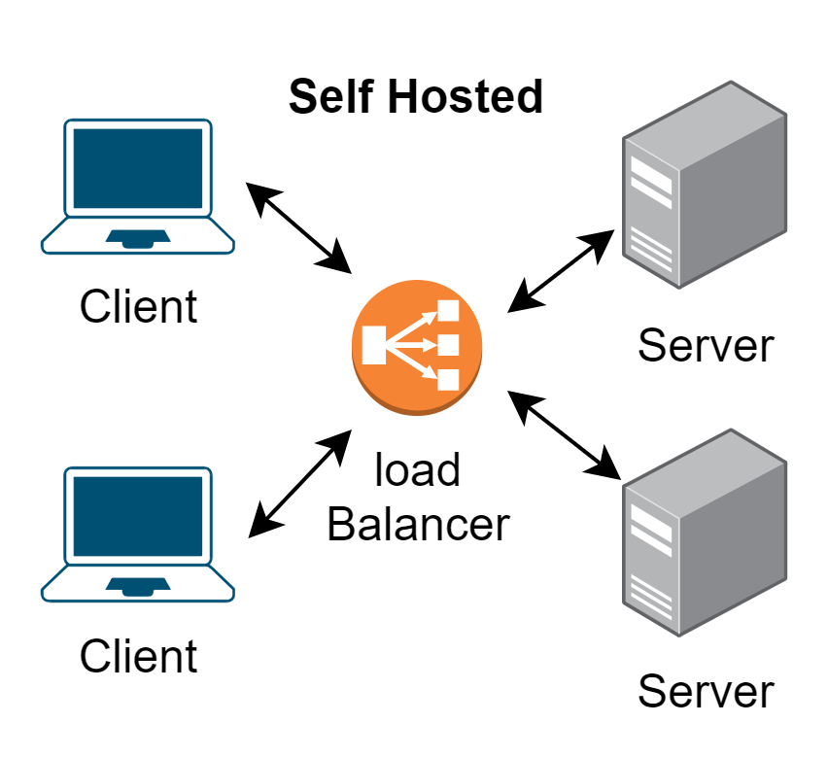
SignalR Scaleout
Scale up means using a larger server (or a larger VM) with more RAM, CPUs, etc or simply adding more servers to handle the load
The Problem we run into is that a client that is connected to one server will not receive messages sent from another server
One way to solve this is to use what is called a backplane.
With a backplane enabled, each application instance sends messages to the backplane, and the backplane forwards them to the other application instances
Redis - An in-memory key-value store. Redis supports a publish/subscribe ("pub/sub") pattern for sending messages.
SQL Server - The SQL Server backplane writes messages to SQL table

Slide 9
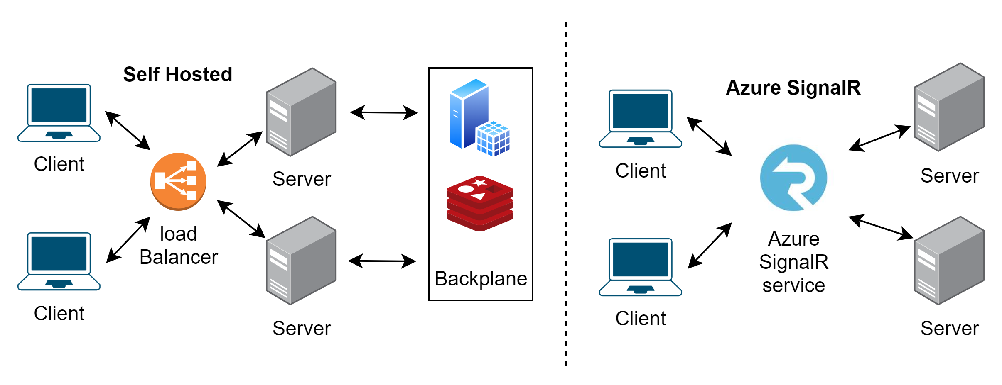
SignalR Scaleout
Only recommended when it runs in the same data center as the SignalR app. Otherwise, network latency degrades performance.
If your SignalR app is running in the Azure cloud, Azure SignalR Service is highly recommended instead of a backplane
Can build serverless applications using functions

Slide 10




Real-World Use Cases
Apps that require high frequency updates from the server. Examples are gaming, social networks, voting, auction, maps, and GPS apps.
Dashboards and monitoring apps. Examples include company dashboards, instant sales updates, or travel alerts.
Collaborative apps. Whiteboard apps and team meeting software are examples of collaborative apps.
Apps that require notifications. Social networks, email, chat, games, travel alerts, and many other apps use notifications.

Slide 11
DEMO

Slide 12


Reference Documentation
Overview of ASP.NET Core SignalR
Tutorial: Get started with ASP.NET Core SignalR

Slide 13


